Slide 1
Used car analysis

Slide 2
Introduction:
The aim of the project is to evaluate used car price listing to identify car brands that are most resilient to depreciation
A car being a depreciating asset usually losses its market value with factors like time and mileage contributing to its decline
Typically used car listing provide brand, mileage, model, colour and technical specifications about a car
Prospective client: Any individual researching for buying a used car. Insights can be hosted on a blog or website with a link to dashboard that allows user to explore different card brands
Dataset overview:
Data for the project is scrapped from eBay’s used car listings
Data Source="https://www.ebay.com/sch/Cars-Trucks/6001/i.html?&LH_ItemCondition=2|0&_trksid=p2050890.m1603"
Data set details: Scrapped dataset contains used car listing for 223,517 cars

Slide 3
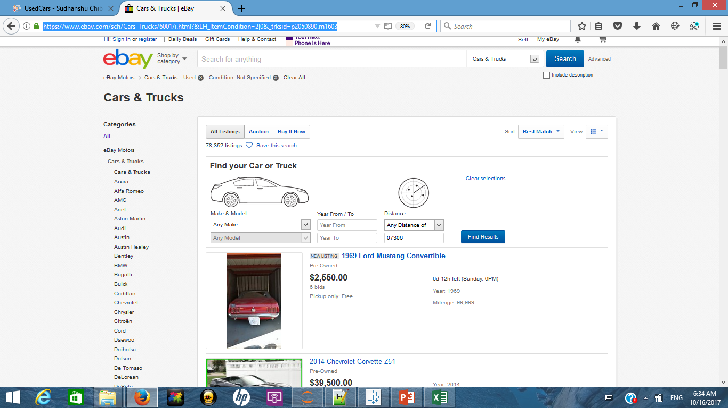
Methodology: Capturing Data
A combination of python libraries Requests and Beautiful Soup is used to scrape data from eBay
On the home page car brand categories are captured and stored as a list
For each list entry (car brand), redirection URL for the car brand is also stored

Slide 4
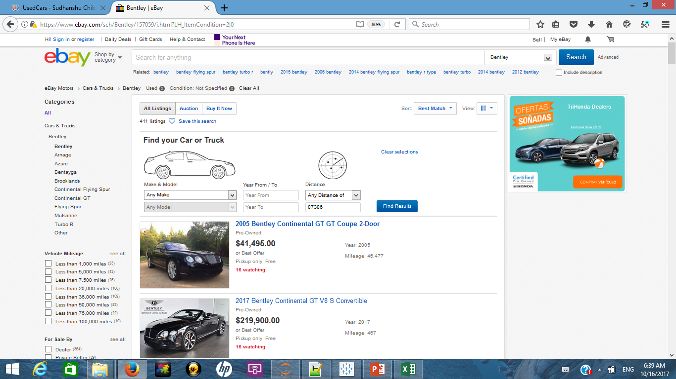
Methodology: Capturing Data
On each redirected brand page, all listed car entries are looped through information like car name, listed price, mileage and year of manufacture are captured
Car information is processed to capture to identify car model
For a given brand all available car listings across multiple pages are captured
IMP: eBay limits the user to a 10,000 results per query criteria. Hence data was captured by looping through brand type.

Slide 5
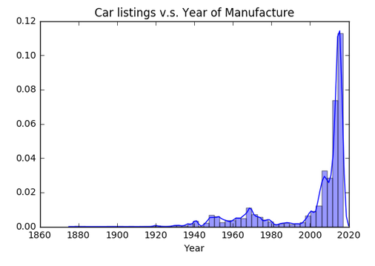
Methodology: Processing and Evaluating Data
Logically incorrect and extreme values were removed from the data set using the below mentioned rules
Removing car listings where "On Road Year" < 0, Cars listed as 2018 or beyond(probable misprint).
Removing car listings where "Price" > 200,000, Outliers.
Removing car listings where "Mileage" > 500,000, Outliers.
Post removal of outliers, the data set had 233,827 cars where an average listing was priced at $38,762 and had run 46,217 miles
Breakup of car listings across the years is shown below:
Most of the used cars available on eBay were manufactured in the last 10 years.
There seems to be some peaks around late 1960’s and early 1970’s car listings too

Slide 6
Methodology: Processing and Evaluating Data
Assumptions:
Data like “Number of Years on Road” and “Mileage” was binned or categorised into ranges of
# of years on road: "LessThan2yrs","2To5yrs","5To10yrs","10To15yrs","15To20yrs","20To50yrs","Heritage“(>50yrs)
Mileage: "LessThan5K miles","5To10K miles","10To20K miles","20To30K miles","30To50K miles","50To75K miles","75To100K miles","100To150K miles","150To300K miles","Roundown“ (>300K miles)
Cut-off values are determined by:
plotting and evaluating histograms of price and mileage data at different cut off values
Ensuring that maximum car brands can be retained in the buckets selected. Having narrower bands was resulting in lesser car brands having presence in defined buckets
Another categorical variable was created based on values of “Number of Years on Road” with cut-off at 15 yrs. Cars with value less than 15yrs were tagged as “Contemporary” and older cars were tagged as “Collectable”
Car listing that did not belong to top 86 brand categories were removed from the dataset. These were cars that did not follow naming convention hence were difficult to map with their respective brands.

Slide 7
Methodology: Calculating Brand evaluation Crosstab
To benchmark car brands against one another a crosstab is plotted on a brands immunity with respect to mileage depreciation and vintage depreciation
The axis on the cross tab signify how immune a car from particular brand is against depreciation w.r.t miles run and number of years on road
Y Axis
Higher immunity against Vintage and Mileage Depreciation
Immunity against Vintage Depreciation (Low to High)
Low immunity against Vintage and Mileage Depreciation
X Axis
Immunity against Mileage Depreciation (Low to High)

Slide 8
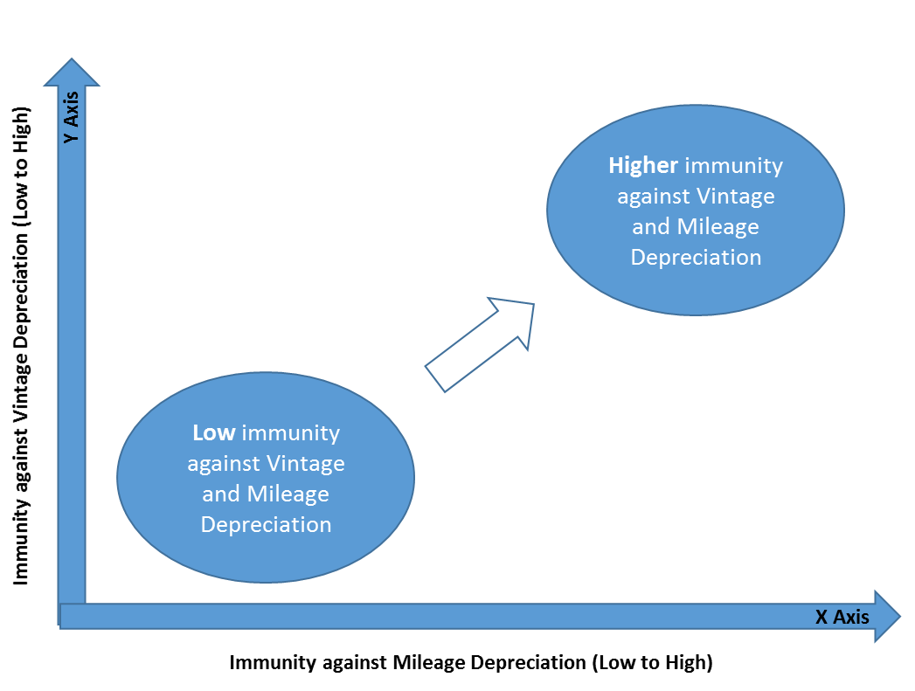
Methodology: Calculating Brand evaluation Crosstab
Axis calculation:
X Axis: To calculate a brand’s position on the X Axis liner regression is used.
Log of car prices is regressed against log of number of miles on the car.
Coefficient of # of miles in the equation is plotted on the X axis for each brand
As the coefficients are negative (price of a car goes down with increase in number of miles driven) higher negative coefficients imply more depreciation for the brand.
Coefficient is high in magnitude
Coefficient is 0

Slide 9
Methodology: Calculating Brand evaluation Crosstab
Axis calculation:
Y Axis: To calculate a brand’s position on the Y Axis concept of single line depreciation is used
Average price of cars for a brand is calculated across defined buckets of 0-2 Yrs, 2-5 yrs, 5-10 yrs and 10 to 15 yrs.
Depreciation is calculated by dividing the average price of the subsequent bucket by the average price of the previous bucket and subtracting the result by 1 (the result is multiplied by 100 to express it in %). For eg. Avg price of Toyota cars in 0-2yrs bracket divided by Avg price of Toyota cars in 2-5yrs bracket accounts for depreciation across the first set of categories
Similarly depreciation is calculated and an average of these depreciation is taken as indicator for a particular brand
To adjust the axis (mark depreciation as low to high on Y axis) the final % value is subtracted from 50 (this is done to scale the axis). So if a car brand A depreciated on an average of 40% in value its position on y axis will be indexed to 10 whereas a brand that depreciated 25% will be at 25. Hence Higher position is desired on the Y axis.
Higher Index coff
Lowe
Index coff

Slide 10
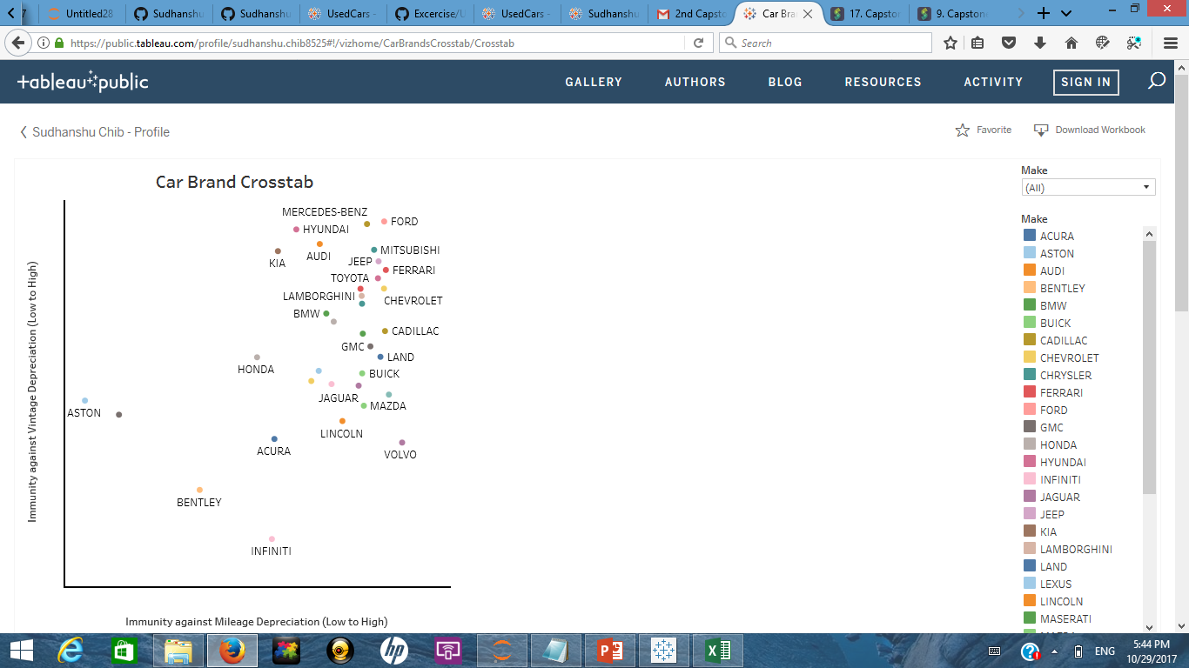
Observations and Insights:
LINK
Ford and Mercedes Benz seem to have maximum immunity against Mileage and Vintage depreciation
Among premium car brands Ferrari and Audi also seem to be doing well as compared to Lamborghini and BMW
Aston Martin, Rolls Royce, Bentley and Infiniti seem to be the least immune brands against depreciation
ROLLS ROYCE

Slide 11
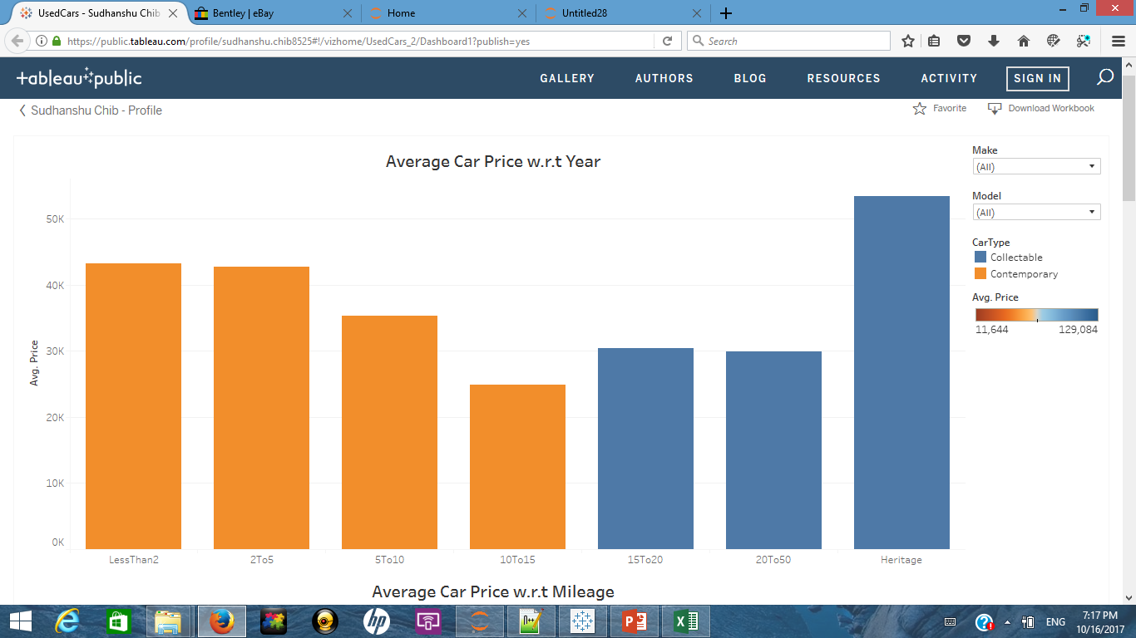

Observations and Insights:
LINK
Generally the price of a car decreases over a period of time (10-15 yrs)
Some car brands appreciate in value post 15 to 20 yrs
So a buyer looking to buy a used car for commute would look to buy a car brand that depreciates the least in the first 10-15 yrs
Whereas a buyer looking at a collectable car might want to invest in a brand that historically appreciates the most

Slide 12
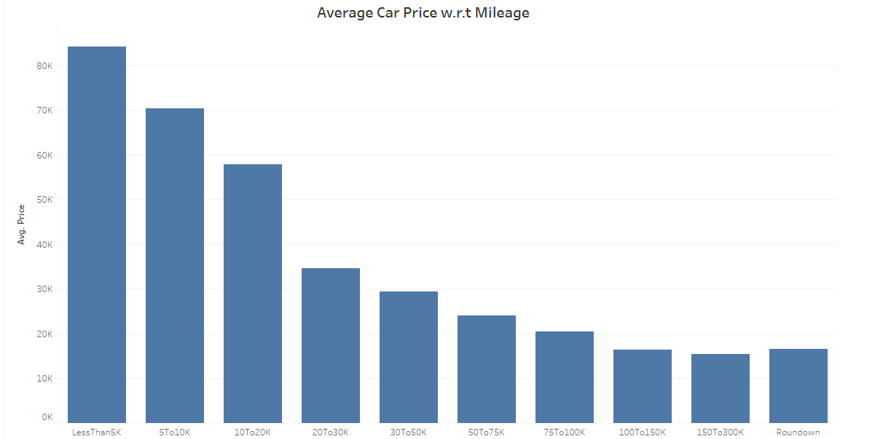
Observations and Insights:
Average Price commanded by cars tends to decrease as number of on road miles increases

Slide 13
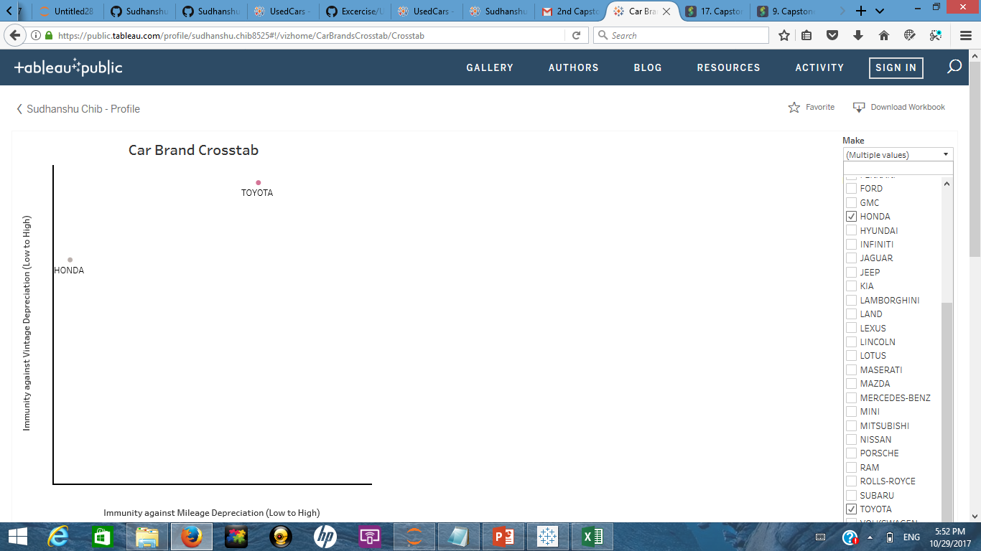
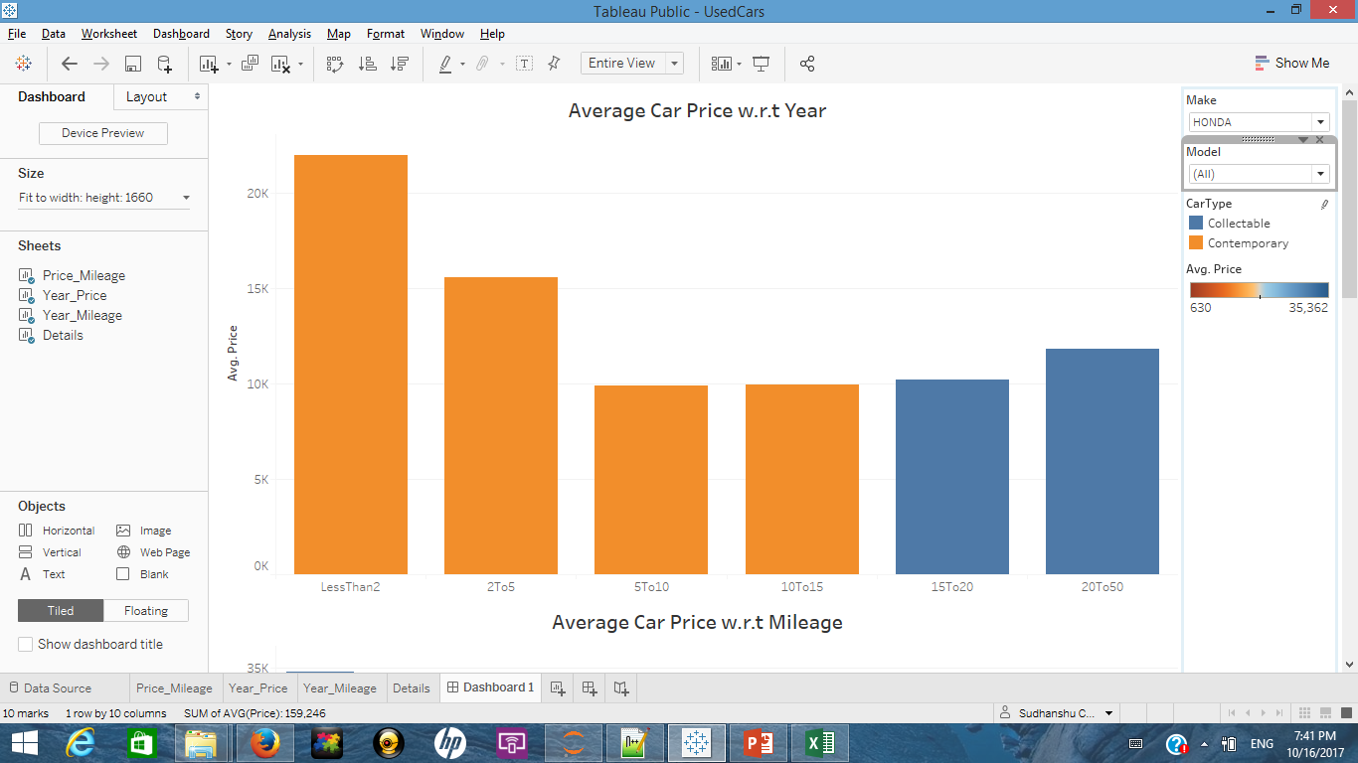
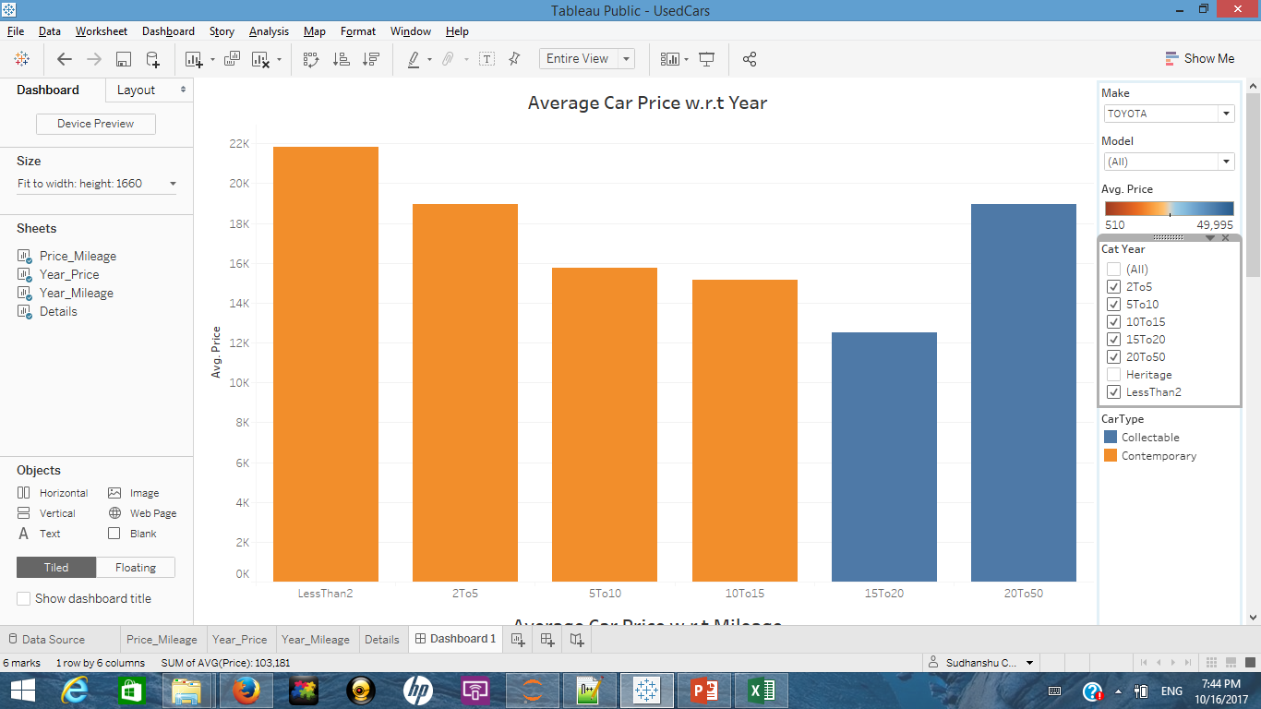
Observations and Insights: Brand Comparison for Honda and Toyota
Honda
Toyota
Cars from Honda are less immune to depreciation in terms of mileage and vintage when compared with Toyota
Toyota mileage coff: -0.3521 and depreciation index 39.23
Honda mileage coff: -0.9356 and depreciation index 29.20

Slide 14
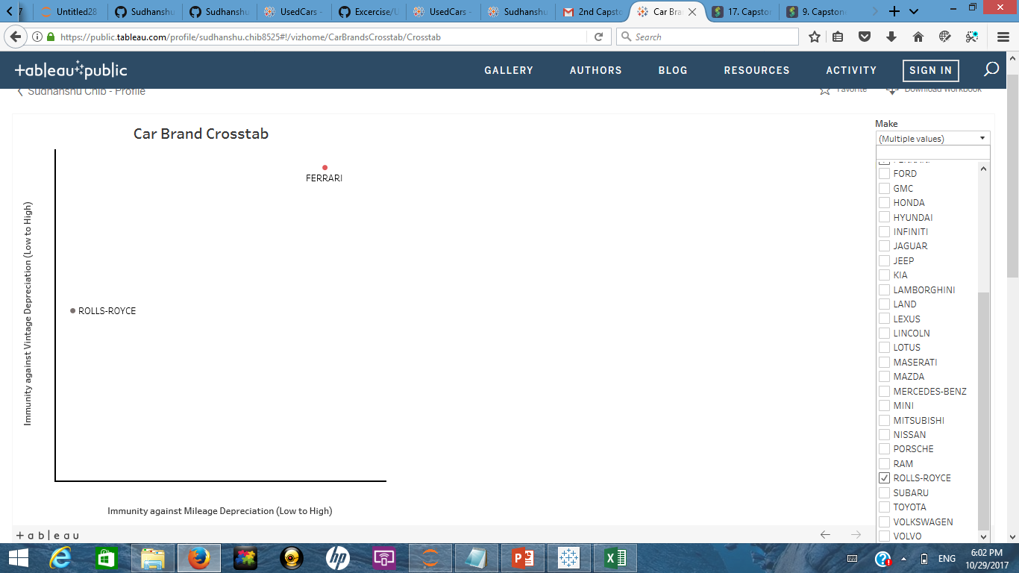
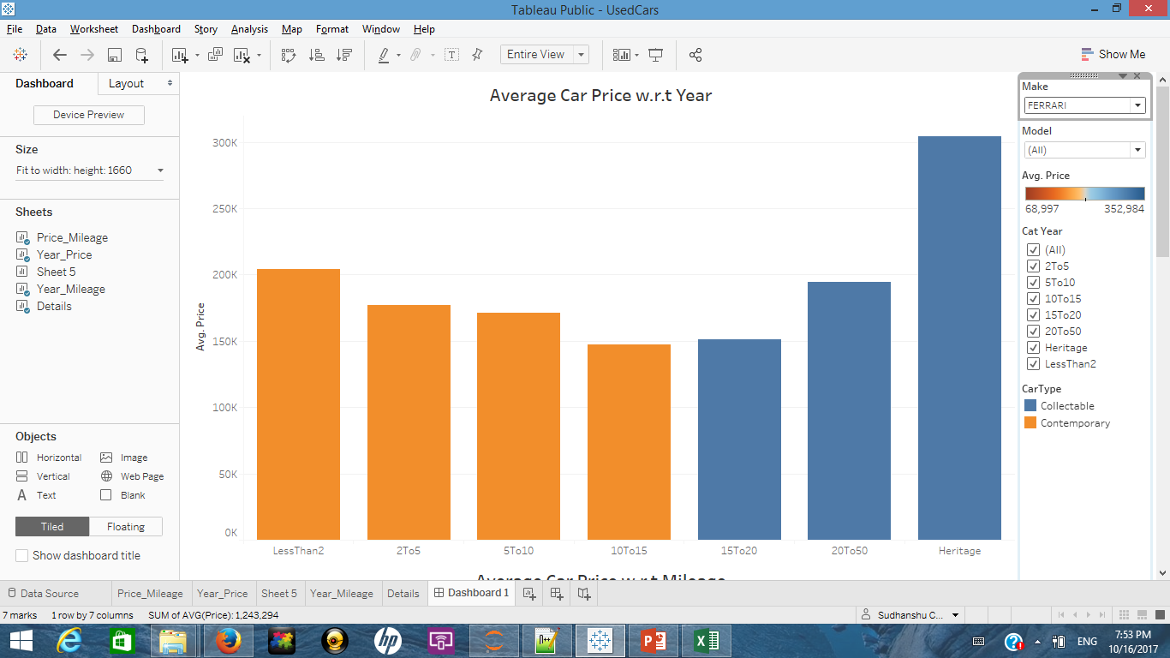
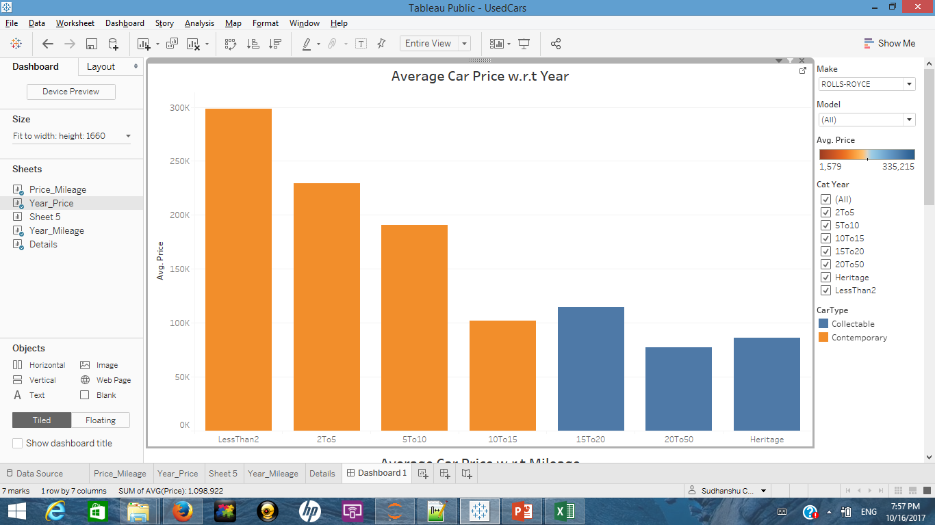
Observations and Insights: Brand Comparison for Ferrari and Rolls-Royce
Ferrari
Rolls-Royce
Ferrari as a brand is more immune to depreciation Rolls-Royce and some Ferrari models have high collectable value.
Rolls-Royce on the other hand depreciates more and older models have little collectable value.
Ferrari mileage coff: -0.314 and depreciation index 40.29
Rolls Royce mileage coff: -1.602 and depreciation index 21.90

Slide 15
Key takeaways:
Different car brands have different immunity against mileage and vintage depreciation
Ranked order list of car brands w.r.t immunity against depreciation (high to low is shared below)
(this list is calculated by distance of brand from the origin, x^2 +y^2 )

Slide 16
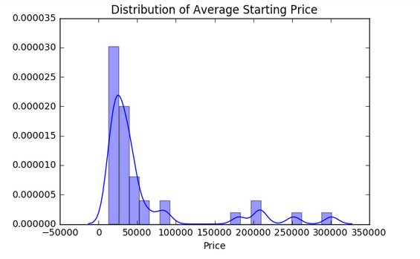
Validation of Ranking System
For all car brands the average price for the brand was calculated by pooling together cars that have been on road for less than or equal to one year
This dataset (car brands + avg starting price) had the following distribution:

Slide 17
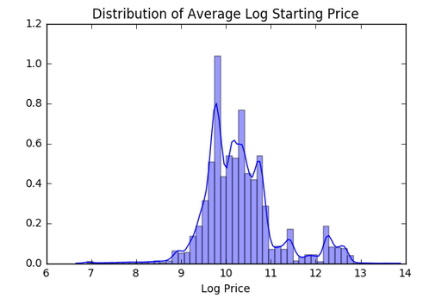
Validation of Ranking System
As the distribution looked skewed to the right (more brands manufacture affordable cars) log of average price was considered
Below is the resulting distribution
With the population distribution now resembling more of normal distribution a quartile segmentation scheme was adopted
Car brands were divided into four buckets based on their log average car price
The four buckets are 1st Quartile: 75-100 percentile, $55,000 and beyond
2nd Quartile: 50-75 percentile, $35,000 to $55,000
3rd Quartile: 25-50 percentile, $24,000 to $35,000
4th Quartile: 0-25 percentile, Less than $24,000

Slide 18
Validation of Ranking System
Entire population of car brands was then evaluated by a two tail T test on depreciation index to identify brands that are most resilient to depreciation
95% confidence interval was considered and with a degree of freedom as 33 the cut off points were 2.042 and -2.042
Any brand that exceeded the cutoff of 2.042 was termed to be statistically resilient to depreciation
Result for all four categories of car brands and entire population of car brands is shared in subsequent slides
Dashboard for the cross tab with categories is available at this link
As evident from the T test results, ranking or cross tab results depict brand resilience in a statistically accurate manner as the brands which are higher in the ranking are also exceed the statistical cut-off by the greatest margin

Slide 19
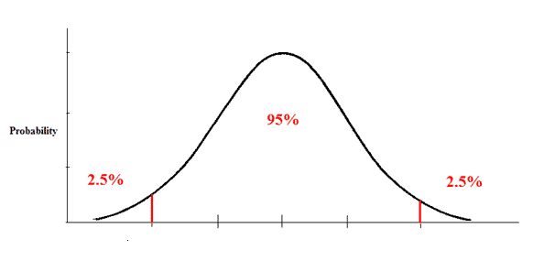

Top brands across categories:
T Distribution
Degree of Freedom 33
1st Quartile (75-100 percentile)
2nd Quartile (50-75 percentile)
3rd Quartile (25-50 percentile)
4th Quartile (0-25 percentile)
FORD: 2.74
MERCEDES-BENZ: 2.74
HYUNDAI: 2.67
FERRARI: 2.15
- 2.042
2.042

Slide 20
1st Quartile Brand Distribution:
T Distribution
Degree of Freedom 33
1st Quartile (75-100 percentile)
LAMBORGHINI: 1.82
LAND ROVER: 1.04
FERRARI: 2.15
ROLL-ROYCE: 0.31
PORSCHE: 1.91
BENTLEY: - 0.64
ASTON
MARTIN
: 0.49
MASERATI: 1.34
- 2.042
2.042

Slide 21
2nd Quartile Brand Distribution:
T Distribution
Degree of Freedom 33
2nd Quartile (50-75 percentile)
MERCEDES-BENZ: 2.74
INFINITY:-1.27
AUDI: 2.74
GMC: 1.18
JAGUAR: 0.68
LEXUS: 0.87
BMW: 1.60
CADILLAC: 1.37
- 2.042
2.042

Slide 22
3rd Quartile Brand Distribution:
T Distribution
Degree of Freedom 33
3rd Quartile (25-50 percentile)
CHEVROLET: 1.91
FORD: 2.74
JEEP: 2.26
VOLVO: -0.04
TOYOTA: 2.04
MINI: 0.74
LINCOLN: 0.23
BUICK: 0.83
- 2.042
2.042

Slide 23
4th Quartile Brand Distribution:
T Distribution
Degree of Freedom 33
4th Quartile (0-25 percentile)
HYUNDAI: 2.67
MITSUBISHI: 2.41
VOLKSWAGEN: 0.07
SUBARU: 1.49
Mazda: 0.04
KIA: 2.39
HONDA: 1.04
CHRYSLER: 1.72
NISSAN: 0.05
- 2.042
2.042

